Slide 1

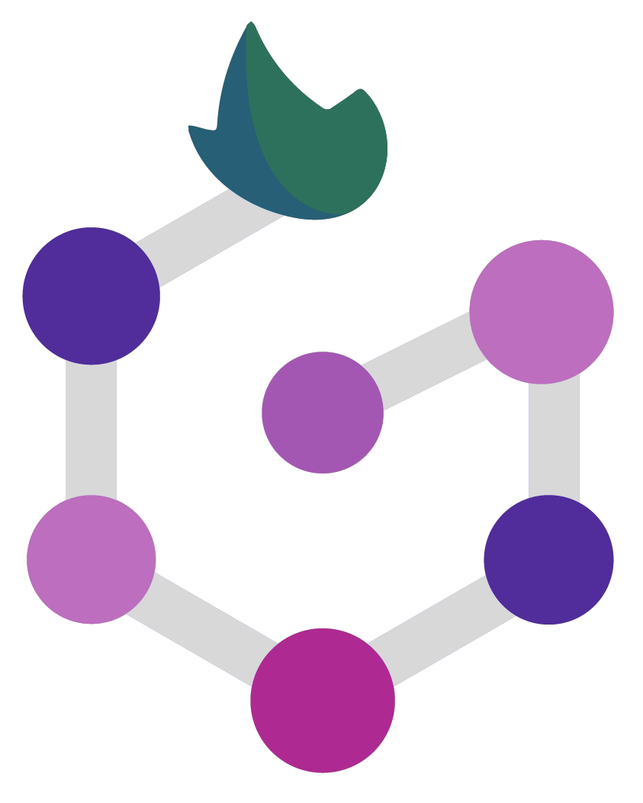

Setting up Nextflow and installing dependencies
Marco Di Marsico

Slide 2
Introduction to Nextflow
Data-driven computational workflow framework ;
Enables scalable and reproducible execution of pipelines;
Supports:
multiple programming languages;
automatic parallelization;
integration with cloud platforms;
error handling system.

Slide 3
Installing Nextflow
Prerequisites:
Bash 3.2 (or later);
Java 11 (or later, up to 18);
Docker.

Slide 4
Installing Nextflow
wget -qO- https://get.nextflow.io | bash
Or
curl -s https://get.nextflow.io | bash

Slide 5
Installing Nextflow
Let’s make it executable
chmod +x nextflow
Make it accessible by your $PATH variable
mv nextflow /home/$USER/bin
(optional) Update Nextflow
nextflow self-update

Slide 7
Some technical information
Connect to the Instance
ssh -i grapediaKey.pk rsa-key-20230215@34.154.39.230
passcode: grapedia

Slide 8
Alternatives?
Well, Conda!
conda install -c bioconda nextflow
Some Documentation on Nextflow
https://www.nextflow.io/
https://github.com/nextflow-io/nextflow#documentation

Slide 9
Managing dependencies
Computational workflows can involve many software components, making installation and maintenance difficult;
Containers encapsulate all the necessary software dependencies in a self-contained, ready-to-run image;

Slide 10
Managing dependencies
The image can be easily deployed on any platform that supports the container runtime;
Container execute in isolation from the hosting system, providing its own file system and processing space.

Slide 12
Managing dependencies
Docker
Singularity
Conda / Bioconda
BioContainers

Slide 13

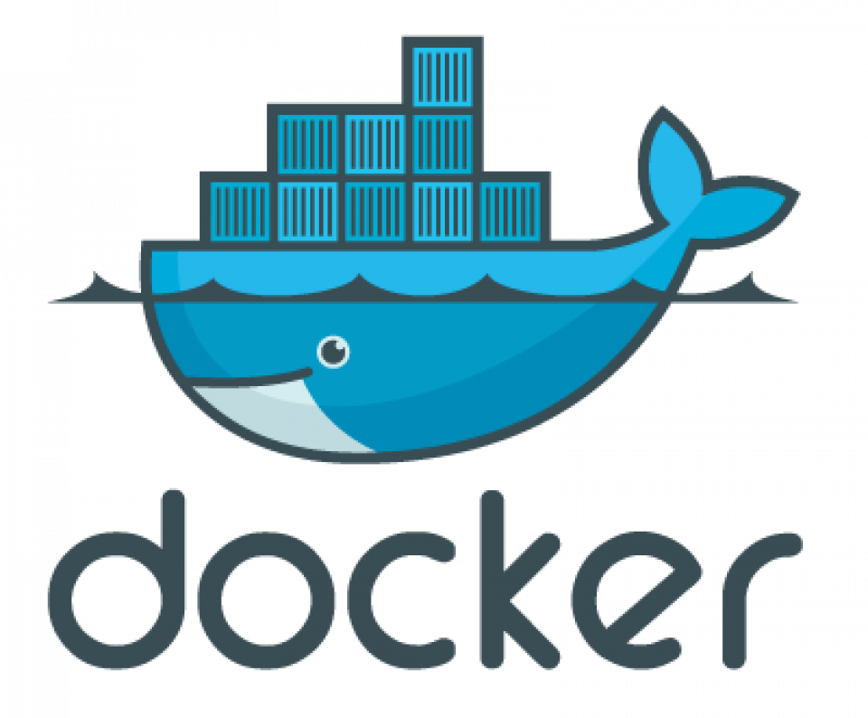

Slide 14
Managing dependencies
We will focus our Grapedia TS on the usage of Docker containers.
Let’s introduce briefly this friendly whale, shall we?

Slide 15
Docker
Open platform for developing, shipping and running apps;
Separates apps from the infrastructure;
Enables to manage the IT in the same way you manage your apps;
Provides several methodologies to improve your work;
Can be downloaded and installed on multiple platforms.

Slide 16
Installing Docker
Remove running Docker files
sudo apt-get remove docker docker-engine docker.io
Check if the system is up-to-date
sudo apt-get update
Install Docker
sudo apt install docker.io

Slide 17
Installing Docker
Install dependency packages
sudo snap install docker
Check the version
docker --version
Pull an image and run it
sudo docker run hello-world

Slide 18
Installing Docker
Is the image been pulled?
sudo docker images
Display all the pulled containers
sudo docker ps -a
Is any container running?
sudo docker ps

Slide 19
Installing Docker
Create Docker group
sudo groupadd docker
Add the User to the Docker group
sudo gpasswd -a $USER docker
Activate the changes
newgrp docker

Slide 21
Singularity
It’ s a container runtime for high-performance computing data centers;
Docker is generally not allowed in these centers due to security constraints;
It implements a container execution model similar to Docker, but with a different design;
Singularity container images are stored as plain files and can be accessed by many computing nodes through a shared file system managed by a batch scheduler.

Slide 22
Conda
Conda is a popular package and environment manager;
Nextflow pipelines have built-in support for Conda;
Nextflow pipelines can automatically create and activate Conda environments based on the dependencies specified by each process.

Slide 23
BioContainers
Another useful resource linking together Bioconda and containers is the BioContainers project;
BioContainers is a community initiative that provides a registry of container images for every Bioconda recipe.

Slide 24
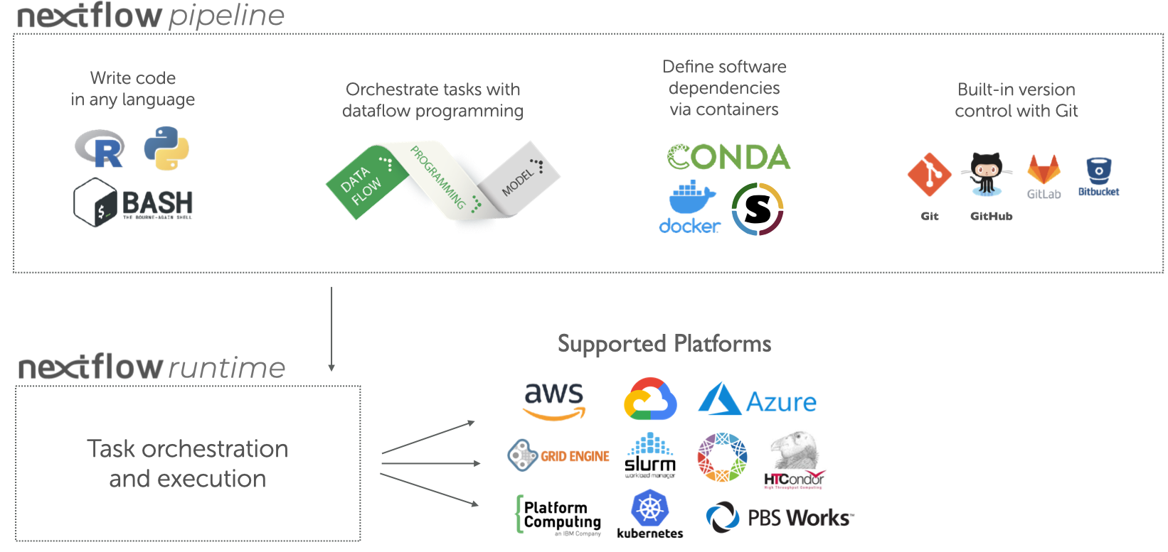
Execution abstraction

Slide 26
Conclusion and next steps
Nextflow is a powerful and user-friendly tool for data-driven computational workflows that enables you to focus on your research and innovation instead of the technical details of workflow management.
Next step: Lunch!

Slide 27
THANK YOU

